Slide 1
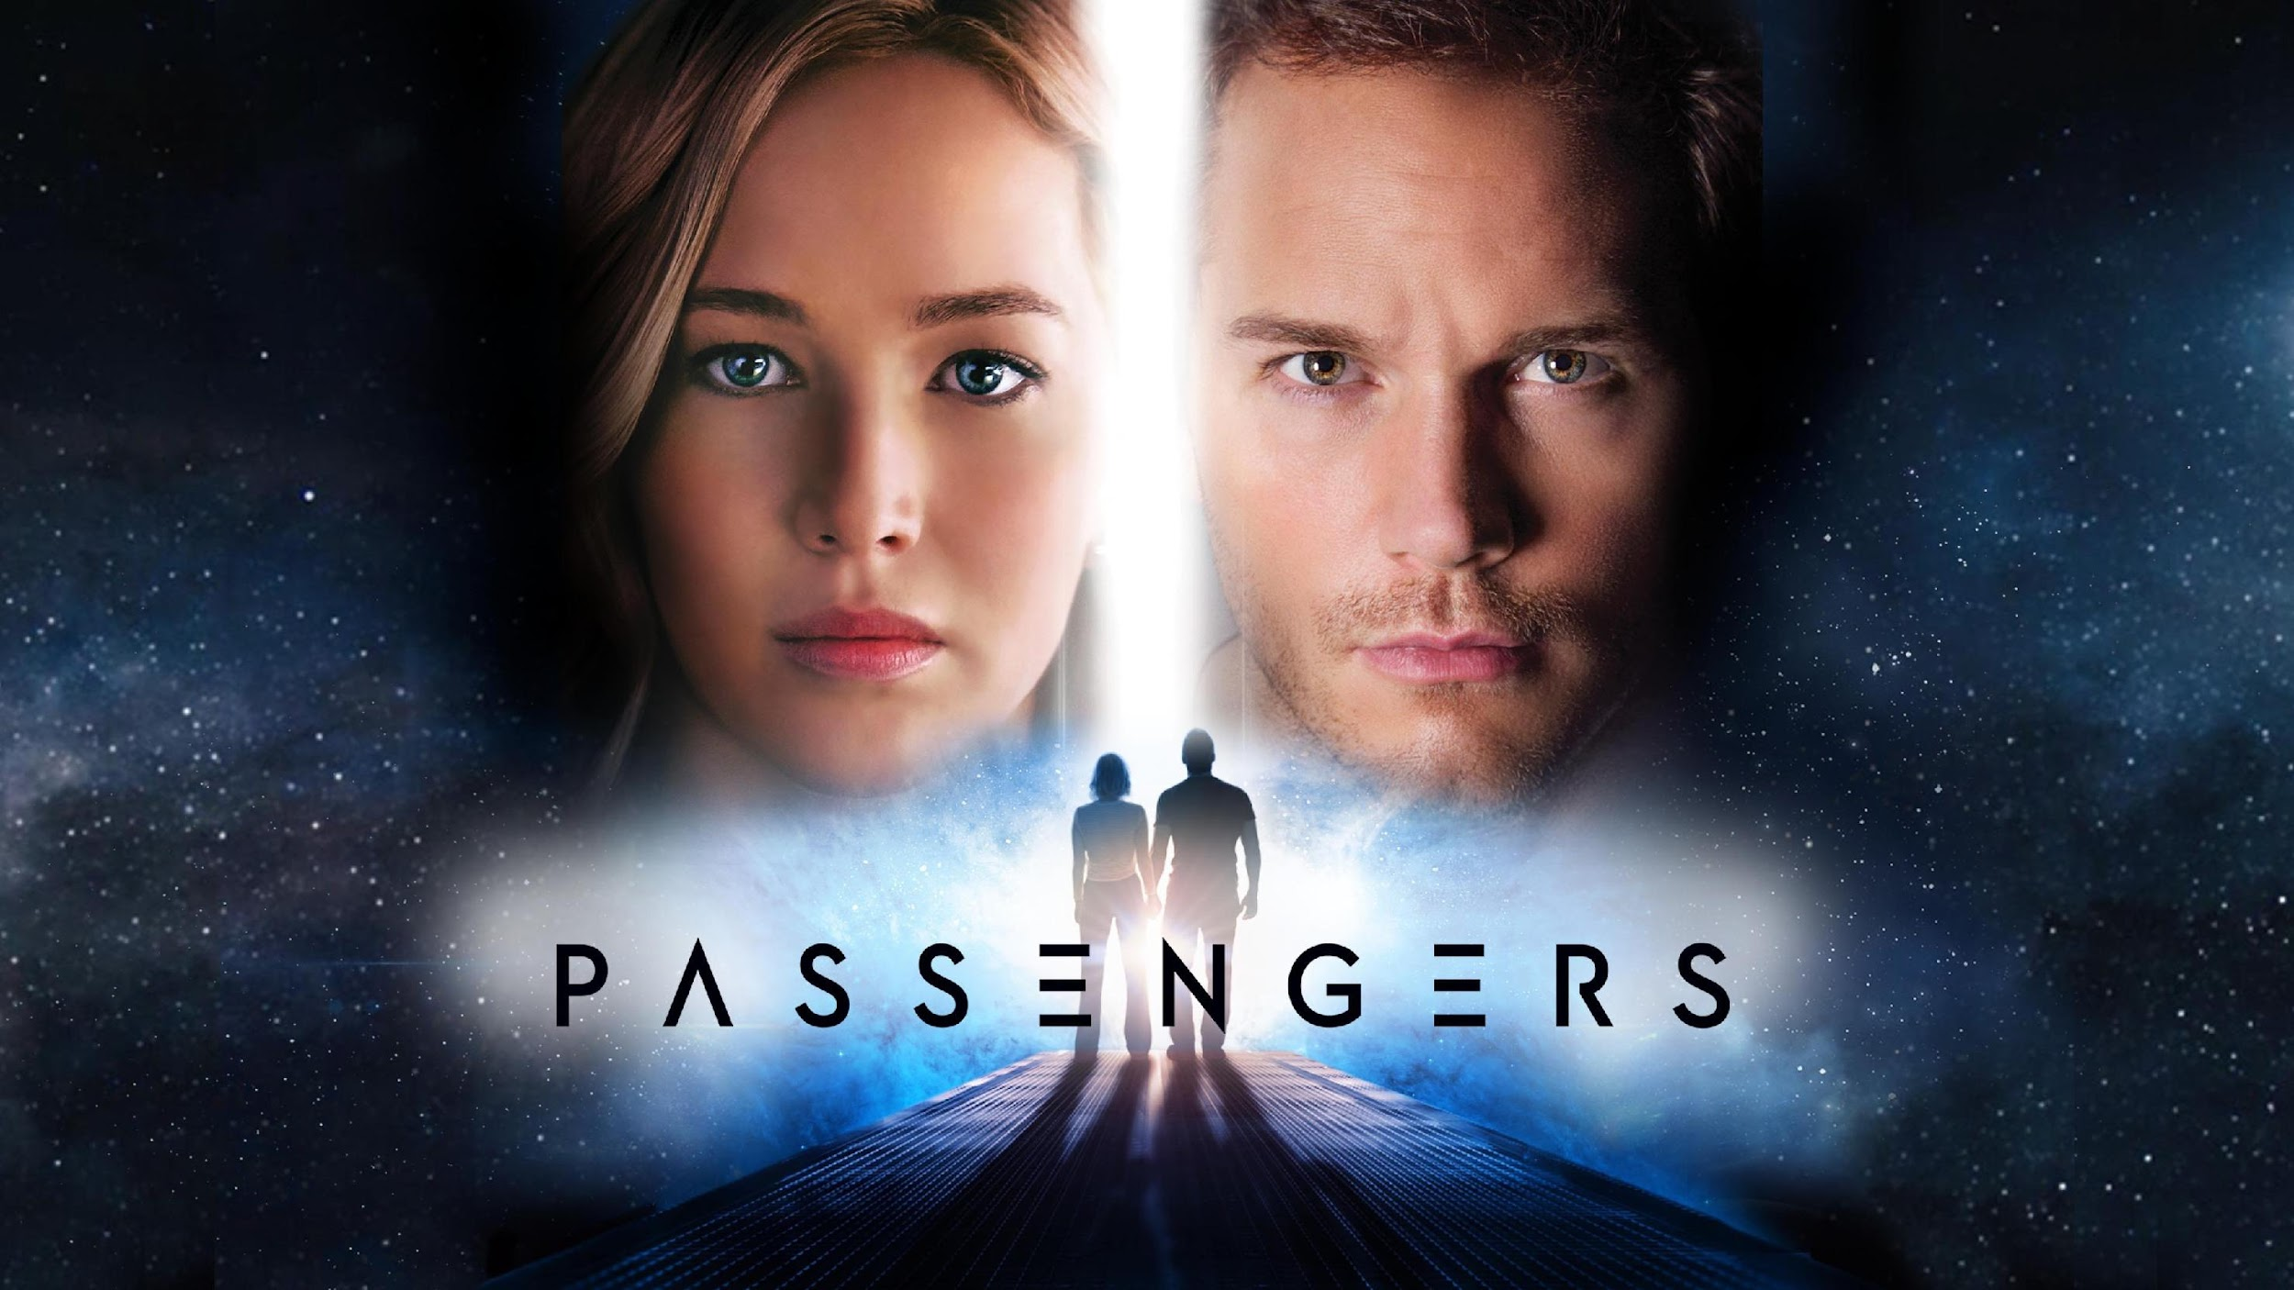
[17]
Passengers(2016) Conclusions
Alex Li, Zackary Perry, Vaansh Mansharamani, Simon Tong
Notes:
Script: Introduce the movie (Hi everyone, this is Passengers (2016) Conclusions of the movie)
Introduce the names of presenters if necessary

Slide 2
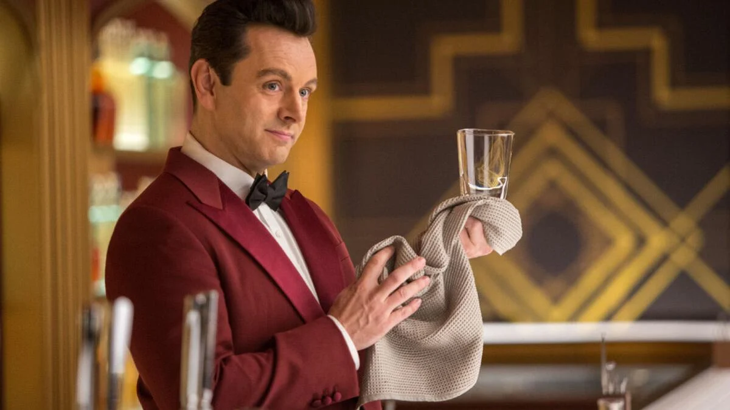
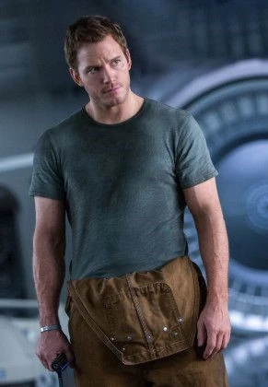
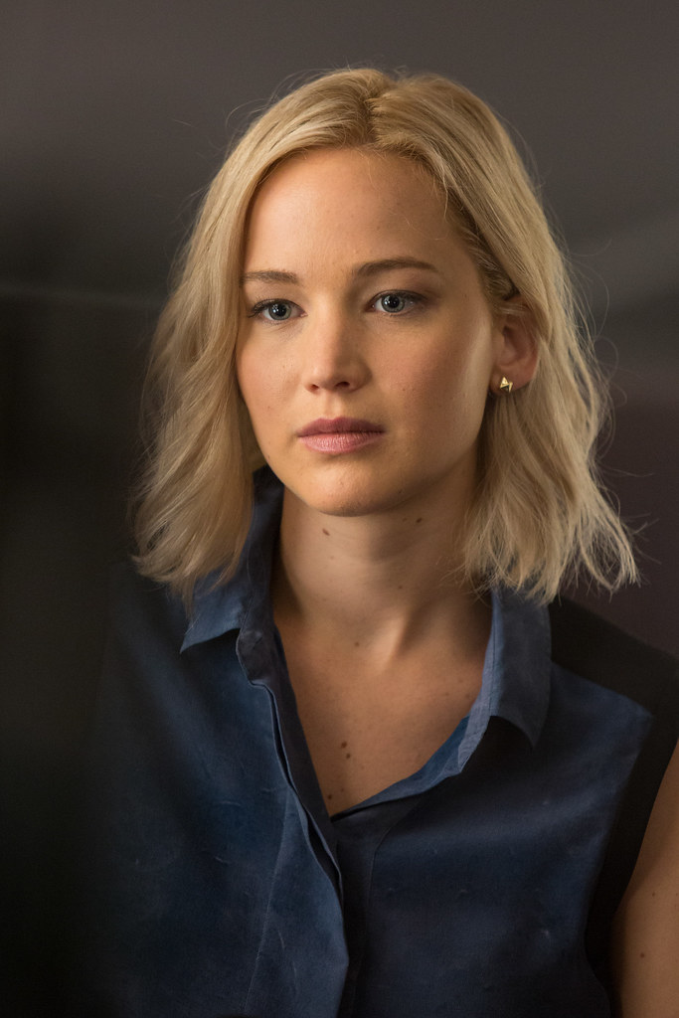
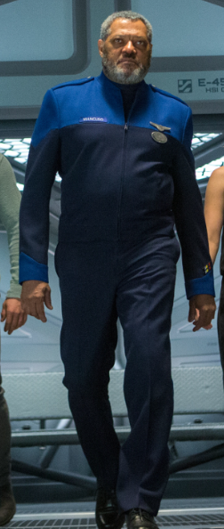
Characters
Arthur the robot bartender who tends the bar
[19]
[1]
[2]
[3]
Jim Preston(mechanic who wakes up first
Aurora Lane(reporter woken up by Jim
Gus Mancuso(plot device, also a deck crew manager)
Notes:
Quickly introduce these Characters: Jim Preston, Aurora Lane, Gus Mancuso:
Script:
Jim: A Engineer back on earth, was travelling to Homestead 2 to work there as an engineer. And was the one that woke up Aurora. Was awoken by a hib pod malfunction
Aurora: A writer from new york city, travelling to Homestead 2 to spend a year and return to earth to report on the experience. Was awoken prematurely by Jim
Gus: Deck Chief of the Avalon, was awoken due to a hib pod malfunction
ZACK SLIDE

Slide 3
(Plot Summary) 2min DELETE WHEN SLIDE 4 DONE
Jim awoken early due to hib pod malfunction. Talks to robot bartender. Wakes up Aurora, Ship starts experiencing failures, Gus (Deck chief) wakes up due to hib pod malfunction, shows Jim and Aurora the situation using his ID privileges, Gus dies(from his hib pod causing sickness or from old age), Jim and Aurora enter the engine room, Jim & Aurora release the pressure of the chamber by Jim going outside to physically release, while Aurora does something else, Ship is saved, Jim Aurora die of old age, but the remaining hibernating passengers are saved, along with the ship.
Make more condensed. Less words, put images if possible
Notes:
ZACK SLIDE

Slide 4
Plot Summary
Jim wakes up on the Starship Avalon 90 years too early
He tries to get access to help in any way he can but fails
After experiencing all the ship has to provide, Jim falls into depression
He meets Aurora who is still asleep, but falls in love with her and struggles with waking her up
After a year, he gives in, tampering with her hibernation pod
It takes some time, but the two of them are able to live together on the Avalon for another year
Notes:
ZACK SLIDE
Introduce each of these points of key detail of the movie, give a general idea so remaining slides aren't too confusing.

Slide 5
Computing Technologies REPLACE WITH PICTURES
The Fusion Reactor
Autopilot system
Spacesuits
Hibernation Pods
Diagnostic System (Backup plan)
Autodoc
Notes:
ZACK SLIDE
Script: And these are some of the computing technologies such as _____________________________________________________________________________________________

Slide 6
Conclusion 1
There needs to be sufficient redundancy measures in place on all computing systems to avoid detrimental scenarios.
Notes:
Script:
And our First Conclusion is There needs to be sufficient redundancy measures in place on all computing systems to avoid detrimental scenarios.

Slide 7
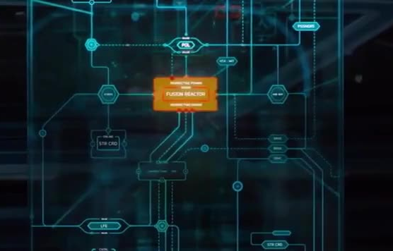
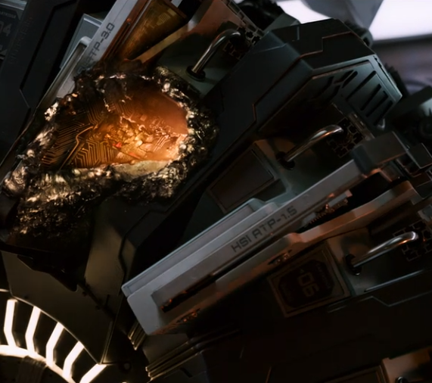
Reason 1 :The Fusion Reactor Computer
[5]
Fusion Reactor Computer controls all power within the ship
Is destroyed by meteor, no sufficient backup plan to repair it
Problem was a hardware related issue, needed to be repaired by a human
[4]
Notes:
Write Notes here on what to say. For this one, explain the fusion reactor computer, what it does, and how it fails, and the effects of its failure.
In the movie, we see the Fusion Reactor Computer being the control of all power within the ship, and this computer fails, causing insufficient backup plans to take place, causing a cascade reaction going from bad to worse.
ZACK SLIDE

Slide 8
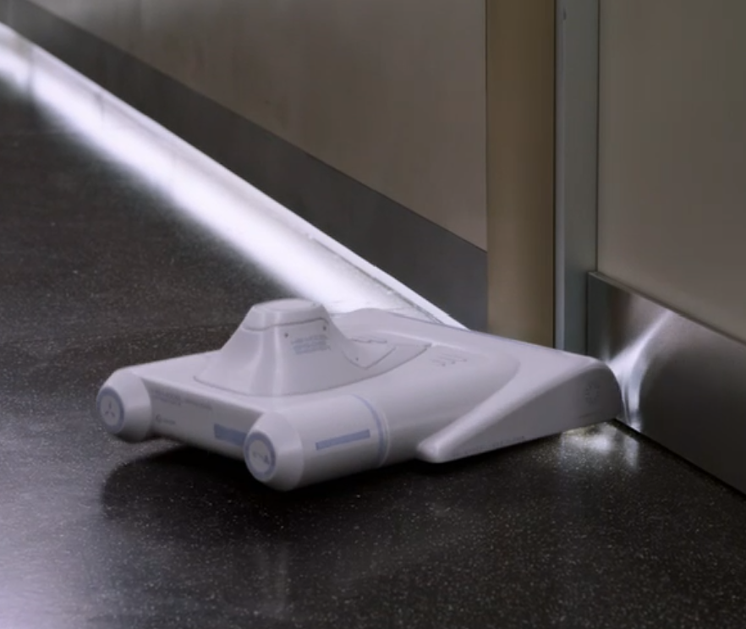
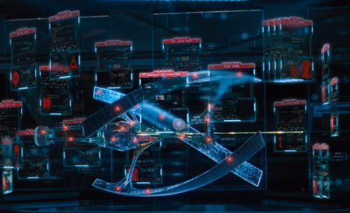
Reason 2: The Backup Plan
The backup plan for the ship was to distribute the job of the fusion reactor computer to control functions of the ship
“Everything on board’s thinking too hard,” resulting in burnt out processors
Put so much confidence in the ship, it didn’t even consider an alternative if something were to happen to it
[21]
[22]
Notes:
Reason of lack of redundancy being bad Put a good script, along with what the picture means when it is there.
ZACK SLIDE

Slide 9
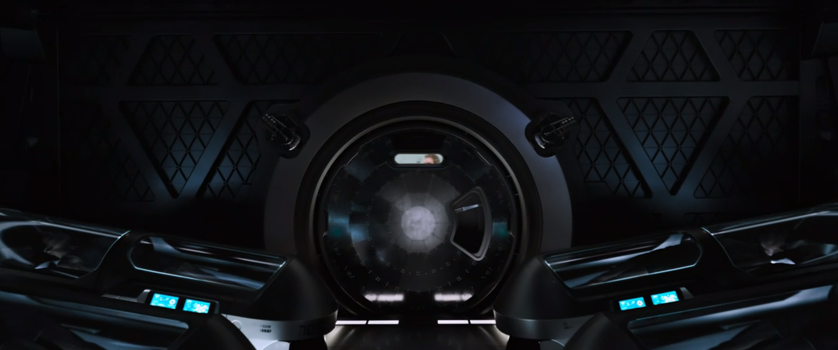
Reason 3: No systems to awake the crew members to look at failures within the ship
Crew is placed in hibernation pods with no way to wake them up, fully relying on Autopilot system to pilot the ship.
Ethically wrong. What if ship gets destroyed? Who is responsible?
[15]
Notes:
Another instance of lack of redundancy in the movie. Write speaker notes for this shit, and relate to ethics at the end i guess
ZACK SLIDE

Slide 10
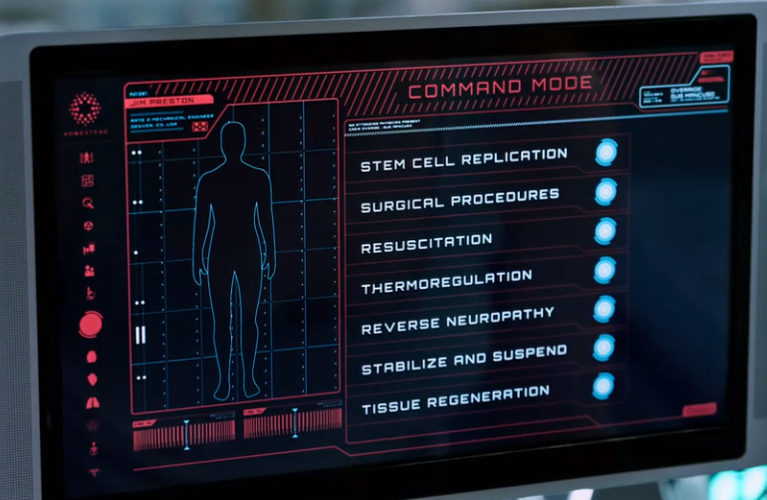
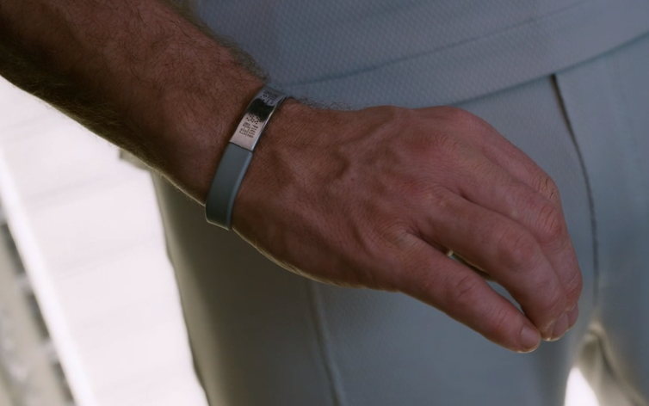
Reason 4: Autodoc & ID
[16]
Autodoc requires ID of a Crew Member to perform advanced commands
The ID of all Passengers controls all their privileges on the ship.
Ethically Inconsiderate, considering emergency
[17]
Notes:
Another example for the lack of redundancy. explain each of these technologies, and relate to the ethics
Advanced commands = “such as postmortem operations and the stopping of metabolic activity”
This is ethically inconsiderate as what if Gus never woke up, then no way of saving Jim’s Life…… Then who is responsible?
Also, for ID, what if it fail, what that passenger do, would that passenger be able access necessities like its room or food, probably not
ZACK SLIDE

Slide 11
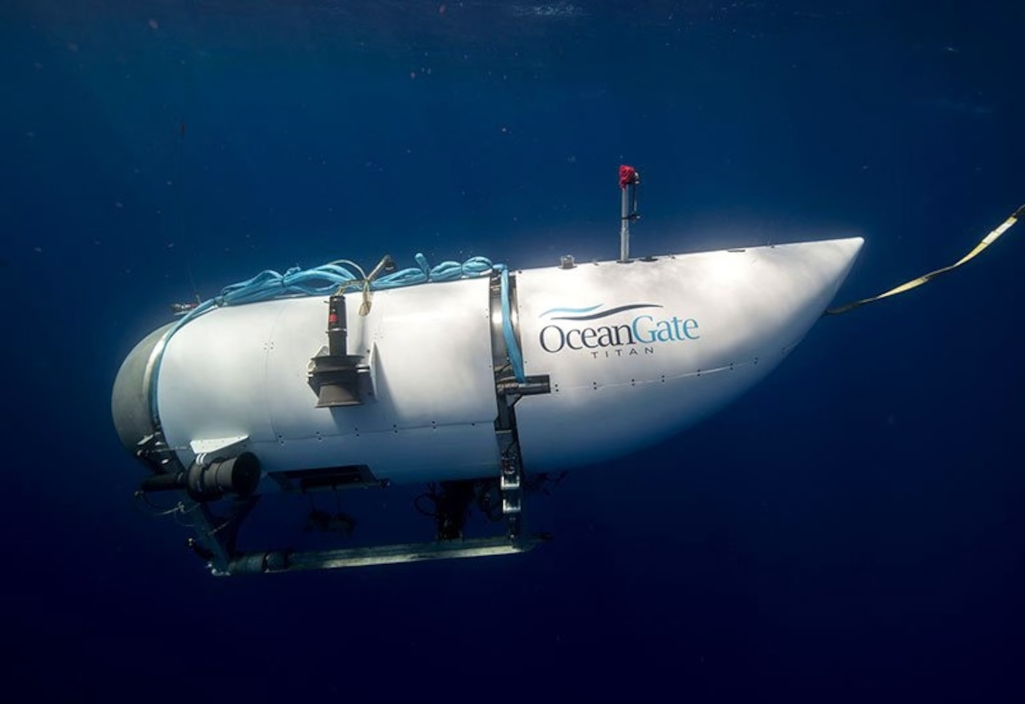
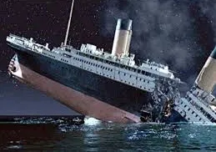
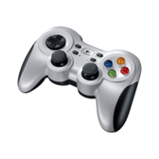
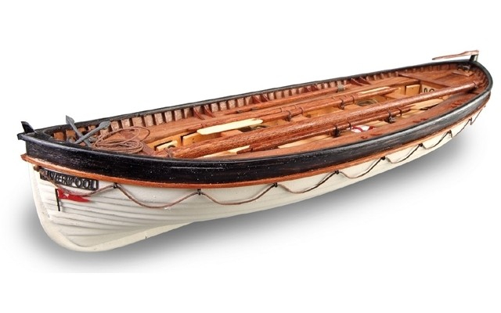
Reason 5: Real life Parallels of Lack of Redundancy
- Ocean Gate Titan Submarine
-The Titanic [1517 people died]
[6]
[7]
[18]
[8]
Notes:
REAL LIFE EXAMPLES. Introduce each of these. OCEANGATE: Use that logitech controller, but no backup when that controller failed cause sub implode
Titanic: Lack of Lifeboats cause these people to die
SIMON SLIDE

Slide 12
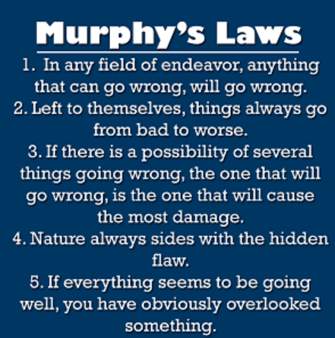
Murphy’s Laws Relating to FIlm
The ship’s reactor getting struck
Avalon overheating to try and fix the problem
Asteroid hitting specifically the ships fusion reactor
Nature = Asteroid
“They never malfunction” - Arthur
[27]
Notes:
The image on the right describes some of Murphys most important laws. These laws were broken throughout the movie, and our thought that was interesting
SIMON SLIDE

Slide 13
Conclusion 2
Emphasizing the importance of honesty regarding safety information is crucial, due to the significant negative impacts that misinformation can have.
Notes:
VAANSH PRESENT

Slide 14
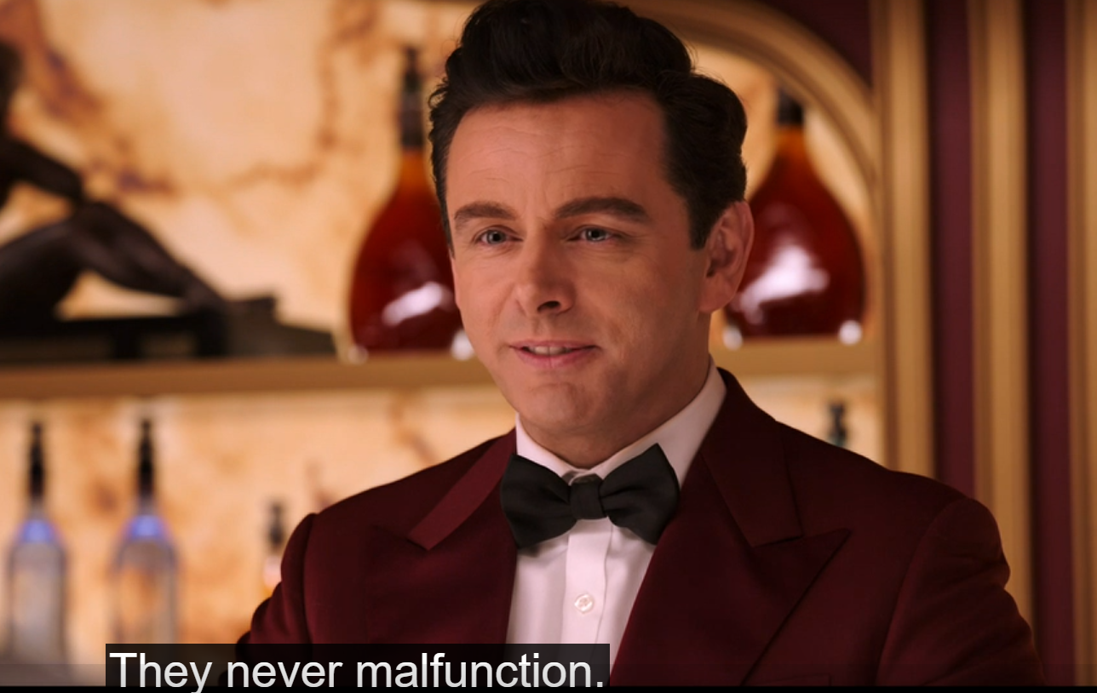
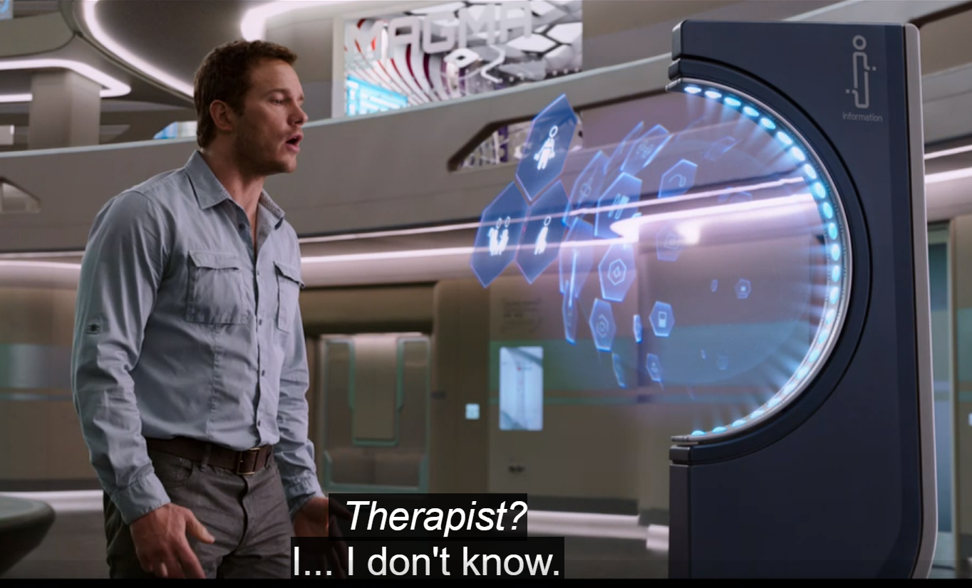
Reasons
Put image of the help desk here
[23]
[24]
Notes:
The false 100% safe advertising by the Homestead Company made it so that everyone believed it was safe, hence lack of redundancy measures(tie into previous conclusion), causing the condition on the ship.
The automated systems aboard the Avalon initially create an illusion of safety and convenience. However, this illusion is shattered when Jim discovers that critical information about the ship's condition has been concealed. This lack of transparency leads to a cascade of events that endanger not only Jim's life but also the lives of all passengers aboard. Therefore, the movie illustrates how honesty about safety information is essential to prevent potentially catastrophic outcomes and maintain trust in technological systems.
VAANSH SLIDE

Slide 15
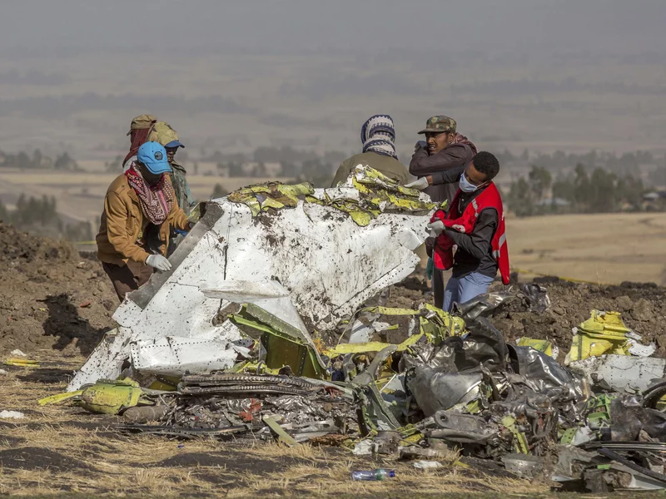
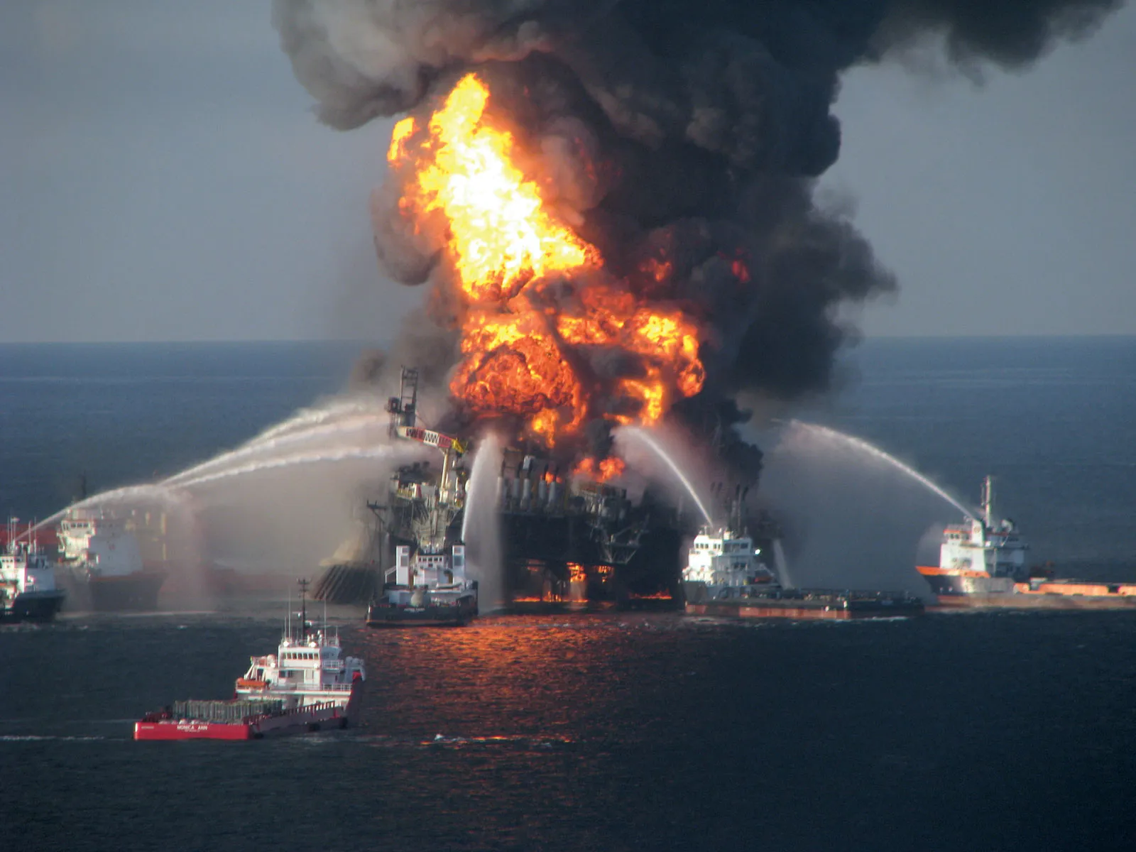
Real World Examples
The Boeing 737 MAX crash[11]
The Deepwater Horizon spill[13]
Notes:
Boeing: small aircraft, to match w/ competition it strapped a huge engine to it and use computer control panel to help this engine ‘fit’ the plane. And when the pilots were unable to control the small plane with such a huge engine, Boeing instead of saying that the engine was too big for the plae, or other technological failures, they blamed the pilots, causing more deaths in necessary, as if they admitted engines were too big, then those airplanes would stop flying or get fixed, preventing unnecessary deaths.
When the Deepwater oil spill happened, the wells owner believed that there were no downsides associated with failure of the rig. This narcissism caused the deaths of 11 people.[14]
VAANSH SLIDE

Slide 16
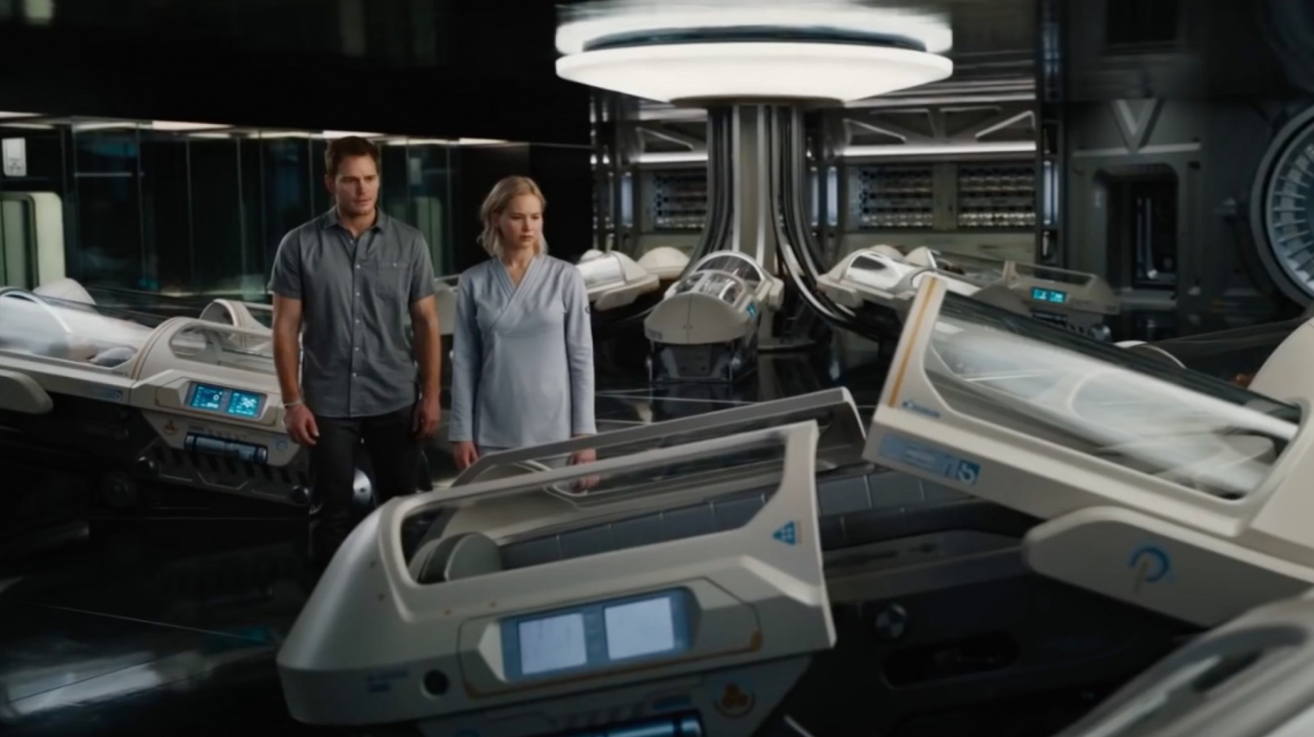
The Problem with - “100% Fail Safe”
“Absolute Certainty Is Not Scientific”
“There must be a way,”- Aurora when talking about going back to sleep in the pod
The Homestead Group advertised the Avalon is 100% safe, although it clearly isn’t
[9]
Notes:
Explain instance in the movie that is a argument for this conclusion. ‘THERE MUST BE A WAY” ALSO THE FALSE ADVERTISING OF HOMESTEAD saying the ship is failproof.
Is this slide too similar to the first slide for this conclusion?
VAANSH SLIDE

Slide 17
Conclusion 3
We should not be over reliant on Autopilot/AI systems for guidance of decision making.
Notes:
ALEX PRESENT
Script: Finally, Our third conclusion is We should not be over reliant on Autopilot/AI systems for guidance of decision making.

Slide 18
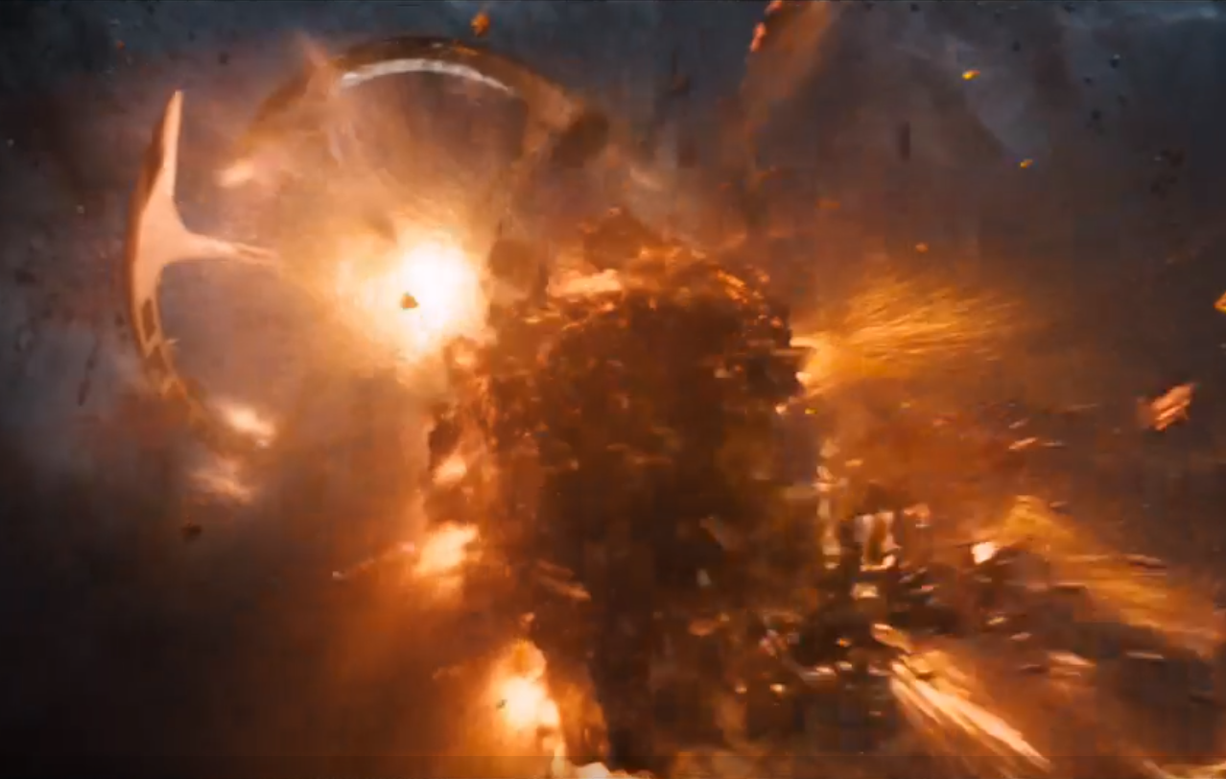
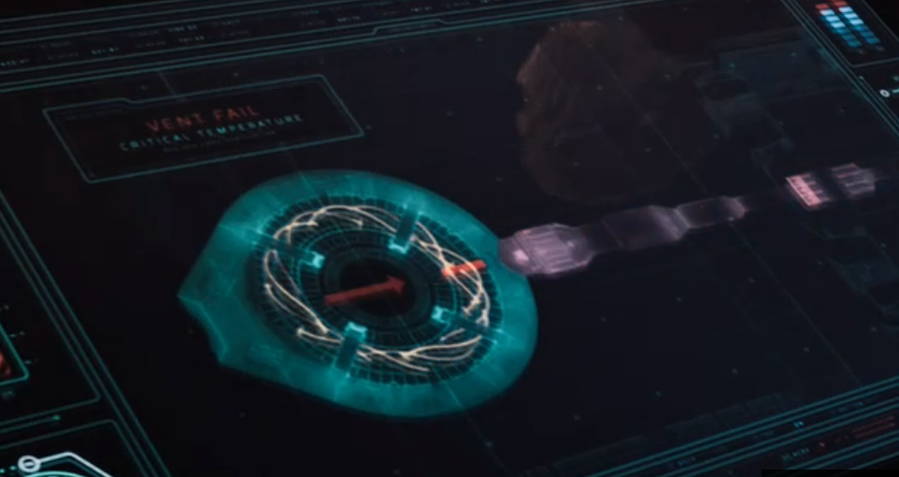
Reasons
[25]
[26]
The Ship was saved by People
Overstressing the system caused Overheating of the reactor core
Notes:
Script: A reason why we shouldn't be solely reliant on AI systems in key decision making is in the movie, we see that the starship Avalon was saved by People: Jim and Aurora, technically Gus as well since he gave them is ID which gave access to key regions of the ship, and allowed Jim and Aurora to save the ship. AND WAS not saved by AI SYSTEMS. We see this in Figure 25, which is the scene where Jim and Aurora successfully manually open up the vent, allowing the reactor core to cool down. Figure 26 is the image showing the reactor core overheating, which is caused from the lack of sufficient redundancy and due to the AI system not being able to solve the issue of the reactor core overheating. As such, these AI systems cannot be trusted in key decision making, as it would’ve just kept on piling on tasks to other computing technologies on the ship until everything fails. Also, we see Arthur give overconfident answers despite them being wrong. Jim “but I am here”, Arthur ”But it is not possible for you to be here” .
ALEX SLIDE

Slide 19
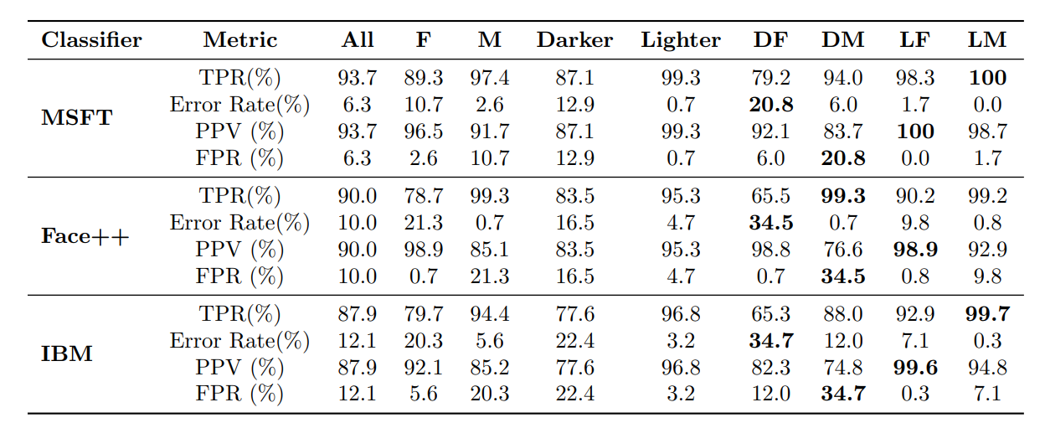
Increase Risk of Reliance on AI for Critical Decision Making
The autopilot system is the sole ‘pilot’ of the starship Avalon
Relating to real life: Modern AI systems can exhibit biases and affect certain groups disproportionately, for example races [1]. Without human intervention, there can be unintended consequences
[10]
[10]
Notes:
Script: Building off the previous slide, the autopilot system is the sole ‘pilot’ of the starship Avalon. This can raise ethical issues, such as what if the Passengers(Jim, Aurora, Gus) didn’t wake up, and due to that asteroid hitting the spaceship, the remaining 4000+ Passengers died, who would be responsible? Homestead Group or the Autopilot system? And what if Gus didn’t wake up, and Jim and Aurora were the only Passengers awake, would they be liable to the remaining hibernating passengers deaths because they tried to fix the issue, but were unsuccessful?
Relating to real-life, we see AI systems in present day exhibit biases and affect certain groups disproportionately in ways such as race. If everyone can direct their attention to Figure 10, we can see that the research from MIT and Microsoft found that women with darker skin had misclassification rates of 20.8%-34.7%, compared to error rates of 0.0%-0.8% for men with lighter skin using algorithms developed by Microsoft, Face++, and IBM.
This can have many impacts, one of which we thought of is Car Insurance. If this disproportionate misclassification rate for different races and genders were as such, it may result in unfair rates for someone that deserves a lower rate. This can be solved with a human looking deep dive into the person's record, but imagine if this AI system was a full-fledged only option to get car insurance, it is a clear form of discrimination and bias and should not be fully trusted.
The Columns represents the type of AI tech used, MSFT means Microsoft facial Technology, Face++ is Face++ Technology, IBM is IBM AI Tech for facial recognition.
TPR means True Positive Rate
FPR means False Positive Rate
PPV means Positive Predictive Value
Error rate means Error Rate
ALEX SLIDE

Slide 20
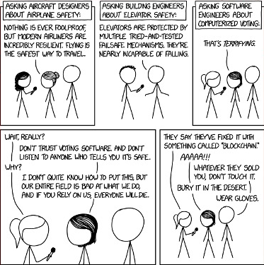
[20]
[20]
Notes:
Script: As we can see, this cartoon is a perfect example of all of what we talked about in this presentation. In this image all the engineers talked about it being nearly incapable or nothing ever being foolproof, which is something the Avalon did not do. They also put too much faith in a software system(the ships navigation) which let an Asteroid hit the fusion reactor on the ship. This cartoon explicitly makes it clear that good software engineers do not trust their own software.
ALEX SLIDE

Slide 21
References
1.MovieStillsDB, Passengers, https://i.pinimg.com/originals/91/28/63/91286398d55f8605e76e18bb9c30b0bd.jpg, (4/22/2024)
2.Flickr, Jennifer Lawrence Films, (Feb 7, 2017), https://live.staticflickr.com/371/31913260434_66b48b71ff_b.jpg
3.https://i.imgur.com/lmKAZzq.jpg (4/22/2024)
4. Columbia Pictures, Passengers, 12/21/16, (1:28:52)
5. Columbia Pictures, Passengers, 12/21/16, (timestamp)
6. Victor Ordonez, Lynn Hilton, Documents detail OceanGate's battle with whistleblower years before fatal Titan submersible implosion, (Feb 8, 2024), https://www.google.com/url?sa=i&url=https%3A%2F%2Fabcnews.go.com%2FUS%2Frun-risk-documents-detail-oceangates-battle-whistleblower-years%2Fstory%3Fid%3D106965104&psig=AOvVaw3IYChEFtIDc95X3rJpCQ20&ust=1713817399037000&source=images&cd=vfe&opi=89978449&ved=0CBIQjRxqFwoTCOirg7yR1IUDFQAAAAAdAAAAABAZ
7.https://i0.wp.com/timmaltin.com/wp-content/uploads/2019/05/broke-in-half.jpeg?fit=259%2C182&ssl=1 (4/12/2024)
8.Amazon, Logitech F710 Wireless Gaming Pad, Silver/Black (940-000117), https://m.media-amazon.com/images/I/51iefaxmqeL.jpg (4/22/2024)
9.Columbia Pictures, Passengers, 12/21/16, (timestamp)
10.Joy Buolamwini, Timnit Gebru, Gender Shades: Intersectional Accuracy Disparities in Commercial Gender Classification, (Jan 15, 2018), https://proceedings.mlr.press/v81/buolamwini18a/buolamwini18a.pdf (4/20/2024)
11.David Schaper, Boeing To Pay $2.5 Billion Settlement Over Deadly 737 Max Crashes, (Jan 8, 2021), https://www.npr.org/2021/01/08/954782512/boeing-to-pay-2-5-billion-settlement-over-deadly-737-max-crashes (4/23/2024)
12.Joseph Herkert, Jason Borenstein, Keith Miller, The Boeing 737 MAX: Lessons for Engineering Ethics, (Jul 10, 2020), https://www.ncbi.nlm.nih.gov/pmc/articles/PMC7351545/ (4/23/2024)
13. Richard Pallardy, Deepwater Horizon oil spill, (Apr 19, 2024), https://www.britannica.com/event/Deepwater-Horizon-oil-spill (4/23/2024)
Notes:
Script: And these are our references, any questions(Asking the class)?

Slide 22
References Cont
14.Marion Hart, The Ethical Lessons of Deepwater, (Dec 22, 2010), https://www.asme.org/topics-resources/content/the-ethical-lessons-of-deepwater (4/23/2024)
15. Columbia Pictures, Passengers, 12/21/16, (16:59)
16. Columbia Pictures, Passengers, 12/21/16, (1:40:11)
17.Columbia Pictures, Passengers, (12/21/16), https://m.media-amazon.com/images/S/pv-target-images/7ab5b49cde2d22538e819c6502d51aaf23cb2c659b509820af938b8864e1931f.jpg (4/23/2024)
18.Stephens Keanu, Titanic Lifeboat, https://www.stephensandkenau.com/wp-content/themes/modeShipYardTheme/timthumb.php?w=640&zc=1&q=100&src=https://www.stephensandkenau.com/wp-content/uploads/2015/10/19016-Titanic-Lifeboat.jpg&a=b (4/24/2024)
19. Linda Barnard, Passengers actor Michael Sheen talks about being a robo-bartender, (Dec 20, 2016), https://www.google.com/url?sa=i&url=https%3A%2F%2Fwww.thestar.com%2Fentertainment%2Fmovies%2Fpassengers-actor-michael-sheen-talks-about-being-a-robo-bartender%2Farticle_eaae723e-01a6-5e66-95a1-92f09866d2c0.html&psig=AOvVaw2mSUNvx6x9sdfII2duOAUi&ust=1714053306511000&source=images&cd=vfe&opi=89978449&ved=0CBIQjRxqFwoTCODK4KWA24UDFQAAAAAdAAAAABAE (4/24/2024)
20.xkcd, Voting Software, https://xkcd.com/2030/ 4/24/2024)
21. Columbia Pictures, Passengers, 12/21/16, (40:32)
22. Columbia Pictures, Passengers, 12/21/16, (1:13:31)
23. Columbia Pictures, Passengers, 12/21/16, (14:07)
24. Columbia Pictures, Passengers, 12/21/16, (9:26)
25. Columbia Pictures, Passengers, 12/21/16, (3:05)
26. Columbia Pictures, Passengers, 12/21/16, 1:29:43)
27. Steve Mackay, The Truth Behind Murphy’s Law, (Sep 27, 2016), https://www.eit.edu.au/the-truth-behind-murphys-law/ (4/20/2024)
Notes:
Script: And these are more references, any questions(Asking the class)?

Slide 23
Questions?

